Slide 1

Datenpersistenz in Android mit Room – ein Einstieg.
Johannes Quast
25. Mai 2021

Slide 2
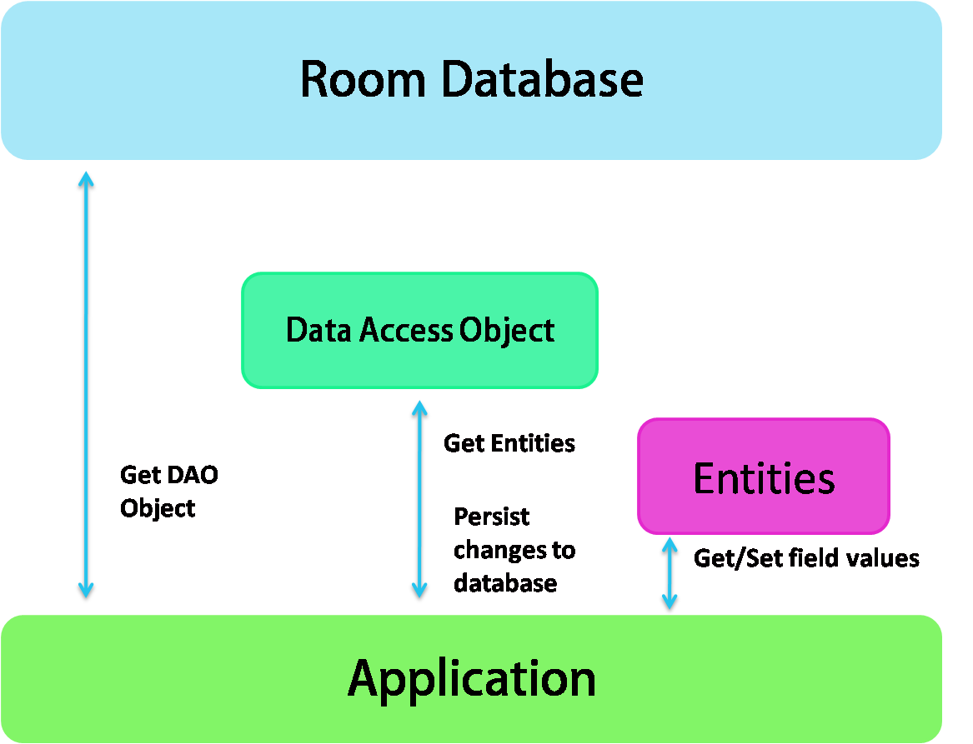
High-Level Architektur
Create DB/DAO
CRUD
Get/Set fields

Slide 3
Entities

Slide 4
Entities
@Entity
data class LocalUser( val userId: Long, val username: String, val firstName: String,
val lastName: String, var lastLogin: Long )
data class LocalUser( val userId: Long, val username: String, val firstName: String,
val lastName: String, var lastLogin: Long )

Slide 5
Entitys – Primärschlüssel
@Entity
data class LocalUser( @PrimaryKey(autoGenerate = true) val userId: Long, val remoteUserId: Long, val username: String, val endpoint: String, var lastLogin: Long )
@PrimaryKey erlaubt es, einen oder mehrere Primärschlüssel festzulegen.

Slide 6
Entitys – Column Modifiers
@Entity data class LocalUser( @PrimaryKey(autoGenerate = true) @ColumnInfo(name = "user_id") val userId: Long,
@ColumnInfo(index = true) val username: String,
val firstName: String, val lastName: String, @ColumnInfo(name = "last_login") var lastLogin: Long )
@ColumnInfo ermöglicht es, Spalten anzupassen.

Slide 7
Entitys – Alternative über @Entity
@Entity( primaryKeys = [ "user_id" ], indices = [ Index("username") ] ) data class LocalUser( @ColumnInfo(name = "user_id")
val userId: Long, val username: String, val firstName: String, val lastName: String, @ColumnInfo(name = "last_login") var lastLogin: Long )
@Entity kann Dinge auch übersichtlicher gestalten.

Slide 8
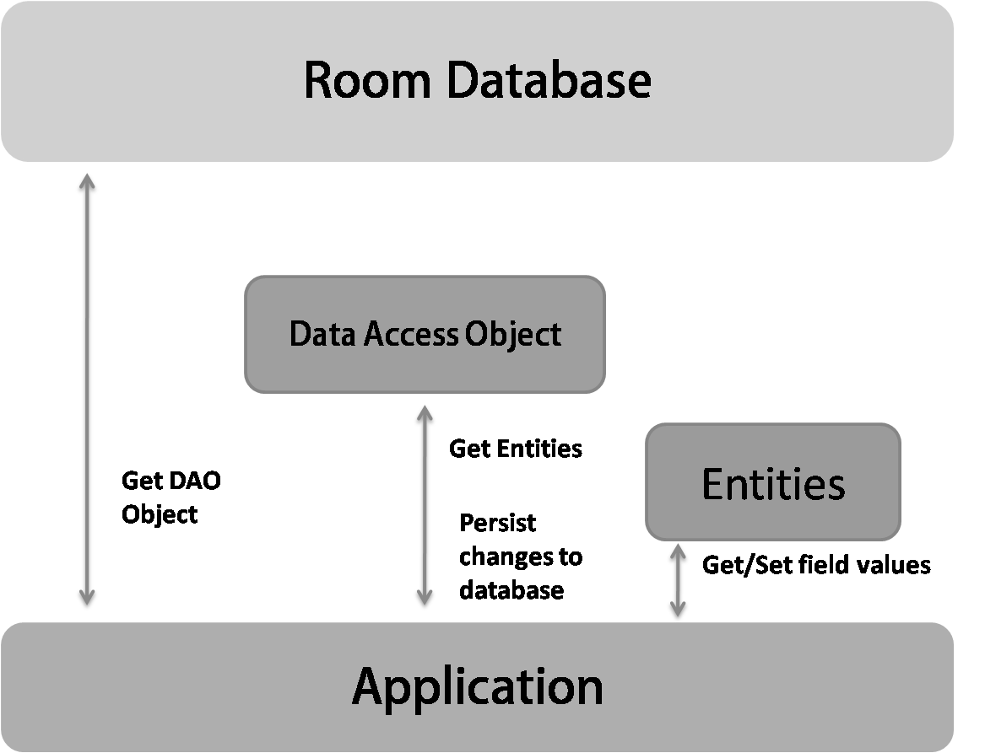
DAOs
Create DB/DAO
CRUD
Get/Set fields

Slide 9
DAO
Hinweis für Room, dass es sich hierbei um ein DAO handelt.
@Dao interface LocalUserDao { ... }
Interface für alle CRUD Operationen.
Liste von abstrakten Methoden.

Slide 10
DAO am Beispiel der User-Tabelle
@Dao interface LocalUserDao { fun getAllUsers(): List<LocalUser> fun createUser(localUser: LocalUser) fun updateUser(localUser: LocalUser)
fun deleteUser(localUser: LocalUser) }

Slide 11
DAO am Beispiel der User-Tabelle
@Dao interface LocalUserDao { @Query("SELECT * FROM LocalUser") fun getAllUsers(): List<LocalUser> @Insert fun createUser(localUser: LocalUser) @Update fun updateUser(localUser: LocalUser)
@Delete fun deleteUser(localUser: LocalUser)
}

Slide 12
DAO am Beispiel der User-Tabelle
@Dao interface LocalUserDao { ...
@Query("SELECT * FROM LocalUser WHERE user_id = (:id)") fun getUserById(id: Long): LocalUser? }

Slide 13
DAO: Einschub zu LiveData
@Dao interface LocalUserDao { @Query("SELECT * FROM LocalUser") fun getAllUsers(): List<LocalUser> @Insert fun createUser(localUser: LocalUser) @Update fun updateUser(localUser: LocalUser)
@Delete fun deleteUser(localUser: LocalUser)
}

Slide 14
DAO: Einschub zu LiveData
@Dao interface LocalUserDao { @Query("SELECT * FROM LocalUser") fun getAllUsers(): LiveData<List<LocalUser>> @Insert fun createUser(localUser: LocalUser) @Update fun updateUser(localUser: LocalUser)
@Delete fun deleteUser(localUser: LocalUser)
}
userDao.getAllUsers().observe(<livecycleOwner>) { userListe -> // Verarbeite aktualisierte Liste von Usern }

Slide 15
DAO: Einschub zu LiveData – Negativbeispiel
@Dao interface LocalUserDao { ...
@Query("SELECT * FROM LocalUser WHERE user_id = (:id)") fun getUserById(id: Long): LiveData<LocalUser?> }

Slide 16
Beziehungen

Slide 17
1:n Beziehung zwischen einem User und vielen Dateien
@Entity data class LocalUser( @PrimaryKey(autoGenerate = true) @ColumnInfo(name = "user_id") val userId: Long,
@ColumnInfo(index = true) val username: String,
val firstName: String, val lastName: String, @ColumnInfo(name = "last_login") var lastLogin: Long )
@Entity data class LocalFile( @PrimaryKey(autoGenerate = true) @ColumnInfo(name = "file_id") val fileId: Long,
@ColumnInfo(name = "user_id") val userId: Long, @ColumnInfo(name = "file_name") val fileName: String )

Slide 18
1:n Beziehung zwischen einem User und vielen Dateien
data class UserWithFiles( @Embedded val user: LocalUser, @Relation( parentColumn = "user_id", entityColumn = "user_id„ ) val files: List<LocalFile> )
@Dao interface LocalUserDao { ... @Transaction @Query("SELECT * FROM LocalUser") fun getUsersWithFiles(): List<UserWithFiles> }

Slide 19
Datenbank
Create DB/DAO
CRUD
Get/Set fields

Slide 20
Datenbank zusammensetzen
@Database( entities = [LocalUser::class, LocalFile::class], version = 1 ) abstract class MyCoolLocalDatabase : RoomDatabase() { abstract fun localUserDao(): LocalUserDao abstract fun localFileDao(): LocalFileDao }
val database = Room.databaseBuilder( context, MyCoolLocalDatabase::class.java, "MyCoolDBName" ).build()
val allUsers = database.localUserDao().getAll()

Slide 21
Live Coding

Slide 22
Fragen?
???

